Slide 1
Digital Portfolio
STUDENT NAME: Sidharth s
REGISTER NO AND NMID: asbruce2428c0564
DEPARTMENT: Bsc AI&ML
COLLEGE: JCT COLLEGE OF ARTS AND SCIENCE/BHARATHIAR UNIVERSITY

Slide 2
DIGITAL PORTFOLIO

Slide 3


AGENDA
Problem Statement
Project Overview
End Users
Tools and Technologies
Portfolio design and Layout
Features and Functionality
Results and Screenshots
Conclusion
Github Link
3/21/2024 Annual Review

Slide 4

PROBLEM STATEMENT
Design and develop a simple portfolio website for sidharth S that effectively showcases his profile, projects, and contact information. The website should be:
Contained in a single HTML file including all HTML, CSS, and JavaScript code (no external files or libraries).
User-friendly and responsive, working smoothly on desktops, tablets, and smartphones.
Structured into three main sections:
About Me — A brief introduction of Abhinav Vijay.
Projects — Display at least three projects with their titles and short descriptions.
Contact — A functional contact form to allow visitors to send messages.
Include a simple navigation menu to switch between these sections seamlessly.
Styled with a clean, modern UI using pleasant colors and readable typography.
Incorporate basic interactive elements such as hover effects and smooth transitions to improve user experience.

Slide 5

PROJECT OVERVIEW
The Sidharth S Portfolio Website project aims to create a clean, modern, and responsive personal portfolio web page that highlights Sidharth S ‘s skills, projects, and provides a means for visitors to get in touch.
This portfolio will be a single-page application built entirely within one HTML file, containing all the necessary HTML structure, CSS styling, and JavaScript functionality. The design will focus on simplicity and usability, ensuring a smooth user experience across all devices, including desktops, tablets, and smartphones.
Key components of the website include:
About Me Section: A concise introduction to Sidharth S, presenting his background and professional interests.
Projects Section: A showcase of at least three projects with titles and descriptions, highlighting his experience and capabilities.
Contact Section: A contact form enabling visitors to send messages directly through the website.
The site will feature a fixed navigation menu that allows users to easily switch between sections without reloading the page. Transitions and hover effects will enhance the interactive feel, while a consistent color scheme and typography will ensure visual coherence.
This project will serve as a personal branding tool for Abhinav Vijay, providing a professional online presence that can be shared with potential employers, clients, or collaborators.

Slide 6

WHO ARE THE END USERS?
Potential Employers and Recruiters Individuals or organizations looking to evaluate Sidharth S’s skills, experience, and projects to consider him for job opportunities or collaborations.
Clients and Business Partners People or companies interested in hiring Sidharth for freelance work, projects, or partnerships who want to learn about his expertise and previous work.
Peers and Fellow Developers Other web developers or tech enthusiasts who want to see Sidharth ’s work, share knowledge, or collaborate on projects.
General Visitors Anyone curious about Sidharth S, including friends, family, or casual visitors exploring the portfolio for personal interest.
Sidharth S Himself To showcase his skills and projects in a professional format that can be updated or shared easily.

Slide 7

TOOLS AND TECHNIQUES
Tools
Code Editor: Any modern text editor such as VS Code, Sublime Text, or Atom for writing HTML, CSS, and JavaScript.
Browser Developer Tools: Chrome DevTools, Firefox Developer Tools, or similar for debugging, testing responsiveness, and inspecting elements.
Version Control (Optional):Tools
Code Editor: Any modern text editor such as VS Code, Sublime Text, or Atom for writing HTML, CSS, and JavaScript.
Browser Developer Tools: Chrome DevTools, Firefox Developer Tools, or similar for debugging, testing responsiveness, and inspecting elements.
Version Control (Optional): Git for source code management and version control (if desired).
Techniques
HTML5: Structuring the webpage with semantic elements for better accessibility and SEO.
CSS3: Styling the page with modern CSS features like Flexbox and Grid for responsive layouts, transitions for smooth UI effects, and media queries for device adaptability.
JavaScript (Vanilla): Adding interactivity such as section navigation, form validation, and dTools
Code Editor: Any modern text editor such as VS Code, Sublime Text, or Atom for writing HTML, CSS, and JavaScript.
Browser Developer Tools: Chrome DevTools, Firefox Developer Tools, or similar for debugging, testing responsiveness, and inspecting elements.
Version Control (Optional): Git for source code management and version control (if desired).
Techniques
HTML5: Structuring the webpage with semantic elements for better accessibility and SEO.
CSS3: Styling the page with modern CSS features like Flexbox and Grid for responsive layouts, transitions for smooth UI effects, and media queries for device adaptability.
JavaScript (Vanilla): Adding interactivity such as section navigation, form validation, and dynamic content updates without external libraries.
Responsive Design: Ensuring the website layout adapts smoothly to different screen sizes including desktops, tablets, and smartphones.
Accessibility Best Practices: Using semantic tags, ARIA roles, keyboard navigation, and proper labeling to make the website usable by all users including those with disabilities. Tools
Code Editor: Any modern text editor such as VS Code, Sublime Text, or Atom for writing HTML, CSS, and JavaScript.
Browser Developer Tools: Chrome DevTools, Firefox Developer Tools, or similar for debugging, testing responsiveness, and inspecting elements.
Version Control (Optional): Git for source code management and version control (if desired).
Techniques
HTML5: Structuring the webpage with semantic elements for better accessibility and SEO.
CSS3: Styling the page with modern CSS features like Flexbox and Grid for responsive layouts, transitions for smooth UI effects, and media queries for device adaptability.
JavaScript (Vanilla): Adding interactivity such as section navigation, form validation, and dynamic content updates without external libraries.
Responsive Design: Ensuring the website layout adapts smoothly to different screen sizes including desktops, tablets, and smartphones.
Accessibility Best Practices: Using semantic tags, ARIA roles, keyboard navigation, and proper labeling to make the website usable by all users including those with disabilities.
Performance Optimization: Keeping the code lightweight by including everything in a single file and minimizing unnecessary scripts to ensure fast loading times.
Performance Optimization: Keeping the code lightweight by including everything in a single file and minimizing unnecessary scripts to ensure fast loading times.
ynamic content updates without external libraries.
Responsive Design: Ensuring the website layout adapts smoothly to different screen sizes including desktops, tablets, and smartphones.
Accessibility Best Practices: Using semantic tags, ARIA roles, keyboard navigation, and proper labeling to make the website usable by all users including those with disabilities.
Performance Optimization: Keeping the code lightweight by including everything in a single file and minimizing unnecessary scripts to ensure fast loading times.
Git for source code management and version control (if desired).
Techniques
HTML5: Structuring the webpage with semantic elements for better accessibility and SEO.
CSS3: Styling the page with modern CSS features like Flexbox and Grid for responsive layouts, transitions for smooth UI effects, and media queries for device adaptability.
JavaScript (Vanilla): Adding interactivity such as section navigation, form validation, and dynamic content updates without external libraries.
Responsive Design: Ensuring the website layout adapts smoothly to different screen sizes including desktops, tablets, and smartphones.
Accessibility Best Practices: Using semantic tags, ARIA roles, keyboard navigation, and proper labeling to make the website usable by all users including those with disabilities.
Performance Optimization: Keeping the code lightweight by including everything in a single file and minimizing unnecessary scripts to ensure fast loading times.

Slide 8
POTFOLIO DESIGN AND LAYOUT
The design and layout of Abhinav Vijay’s portfolio website aim to create a clean, modern, and user-friendly experience that effectively highlights his personal brand and work. The key aspects of the design include:
1. Overall Structure
Single-page layout divided into three main sections: About Me, Projects, and Contact.
A fixed navigation bar at the top for easy access to each section without page reloads.
Smooth transitions between sections to provide a seamless user experience.
2. Color Scheme and Typography
Color Palette: Soft gradients and muted background colors combined with a primary accent color (e.g., a shade of blue) to highlight interactive elements and headings.
Typography: Clean and readable sans-serif fonts with appropriate font sizes and spacing for headings, body text, and buttons to ensure legibility.
3. Navigation Bar
Horizontally centered navigation with clearly labeled buttons.
Active section is visually highlighted with color changes and underlines.
Responsive layout to accommodate smaller screens (e.g., smaller spacing or stacked menu on mobile).
4. About Me Section
Prominent heading with Abhinav Vijay’s name.
A brief, engaging paragraph introducing Abhinav and his professional background.
Simple layout with sufficient padding and line spacing for easy reading.
5. Projects Section
Grid-based layout displaying project cards.
Each project card contains a project title and short description.
Cards feature hover effects that enhance interactivity and highlight the project.
Responsive design allows grid to adjust to screen size by stacking cards on smaller devices.
8

Slide 9
FEATURES AND FUNCTIONALITY
. Single Page Navigation
Smooth Section Switching: Navigation buttons at the top allow users to switch between About, Projects, and Contact sections without reloading the page.
Active State Indication: The current section is visually highlighted in the navigation menu for better orientation.
2. About Me Section
Personal Introduction: A concise, welcoming paragraph that describes Sidharth S’s background, skills, and interests.
3. Projects Showcase
Project Cards: Each project is presented in a card format with a title and short description.
Interactive Hover Effects: Project cards have subtle hover animations to enhance visual appeal and interactivity.
Responsive Grid Layout: Projects adjust layout dynamically to fit screen size, maintaining readability and aesthetics on all devices.
4. Contact Form
User Input Fields: Collects name, email, and message from visitors.
Form Validation: Checks required fields before allowing submission to prevent incomplete messages.
Visual Feedback: Input fields highlight on focus, and the submit button changes style on hover for better user experience.
Submission Handling: (Note: In this basic version, form submission may just show an alert or console log since no backend is involved.)
5. Responsive Design
Mobile Friendly: The entire layout adapts to various screen sizes including smartphones and tablets.
Touch-Friendly Interactions: Buttons and inputs are sized and spaced to accommodate touch input comfortably.
6. Accessibility
Keyboard Navigation: All interactive elements are accessible via keyboard (Tab key).
Semantic HTML & ARIA: Proper HTML elements and ARIA attributes ensure screen readers can interpret the content accurately.
7. Visual Enhancements
Smooth Transitions: Fade-in animations when switching between sections.
Color and Typography: Clean color palette and legible fonts improve readability and user engagement.
Consistent Layout: Uniform spacing and alignment across sections for a polished appearance.

Slide 10
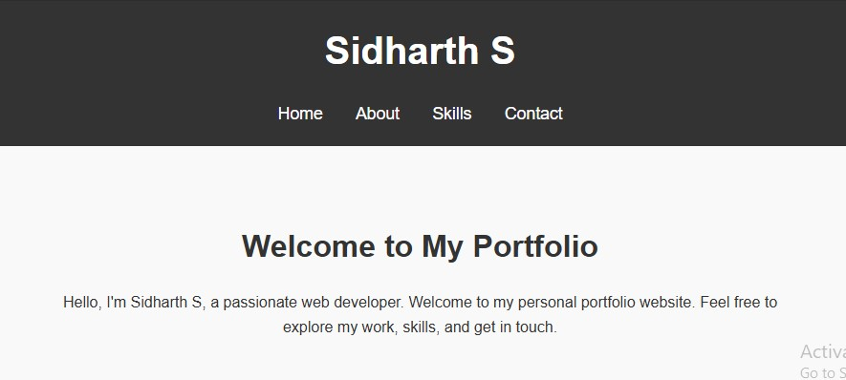

RESULTS AND SCREENSHOTS
3/21/2024 Annual Review
10

Slide 11
CONCLUSION
11

